Slide 1

Green Pace
Security Policy Presentation
Developer: Nicole Penner

Slide 2

OVERVIEW: DEFENSE IN DEPTH
A security policy is key to helping ensure security of a system.
Security policies should be taken seriously to ensure safety of information and quality of your system.
Security needs to be thought about at every step of the development process to ensure there are many layers of security present.
If there are many levels of security implemented, if one fails another can step in to protect the system

Slide 3
THREATS MATRIX
Likely/Low Priority STD-007-CPP | Likely/High Priority STD-002-CPP STD-003-CPP STD-004-JAV STD-005-CPP STD-009-CLG
Unlikely/Low priority STD-001-CLG STD-006-CLG | Unlikely/High Priority STD-008-CPP STD-010-CLG
Likelihood of Threat Occurring
Priority of taking care of the Threat

Slide 4
10 PRINCIPLES
Validate Input Data: STD-001-CLG, STD-003-CPP, STD-004-JAV, STD-009-CLG
Heed Compiler Warnings: STD-001-CLG, STD-002-CPP, STD-005-CPP, STD-010-CLG
Architect and Design for Security Policies: STD-001-CLG, STD-004-JAV, STD-007-CPP, STD-010-CLG
Keep it Simple: STD-001-CLG
Default Deny
Adhere to the Principles of Least Privilege
Sanitize Data Sent to Other Systems: STD-003-CPP, STD-004-JAV
Practice Defense in Depth: STD-002-CPP, STD-003-CPP, STD-008-CPP
Use Effective Quality Assurance Techniques: STD-005-CPP, STD-006-CLG, STD-007-CPP, STD-009-CLG, STD-010-CLG
Adopt a Secure Coding Standard: STD-008-CPP

Slide 5
CODING STANDARDS
STD-001-CLG Data Type: All data types should be defined before they are used.
STD-002-CPP Data Value: A variable should be initialized with a value before it is read.
STD-003-CPP String Correctness: There should be sufficient storage for both the character data and the null terminator.
STD-004-JAV SQL Injection: SQL injection should be prevented.
STD-005-CPP Memory Protection: Memory that has been freed should not be accessed by the system.
STD-006-CLG Assertions: Static assertions can be used to test values in constant expressions. It is used to find and eliminate vulnerabilities.
STD-007-CPP Exceptions: All exceptions need to be handled.
STD-008-CPP Inputs & Outputs: Files should be closed when they are no longer needed.
STD-009-CLG Integer: Operations performed should not result in an overflow.
STD-010-CLG Array: Array bounds should be explicitly defined.

Slide 6
ENCRYPTION POLICIES
At rest: This refers to the initial state of digital data, when it is at rest means it is stable and not traveling through the system or being acted on.
Encryption at rest depends on what physical or logical data sources or storage need to be protected
In fight: This refers to data when it is “in motion”, as in being transmitted.
Data should be sent through secure and encrypted channels, such as by HTTPS
In use: This refers to protecting data that is not just passively being stored. This could include data that is being edited, accessed, or processed by the system.
Data should be handled as securely as possible while in use

Slide 7
TRIPLE-A POLICIES
Authentication: The first step in the Triple-A Framework process, this is how the system or network verifies a user’s identity. It makes sure the user is who they are claiming to be.
Authorization: This is the second step in the Triple-A Framework process, it checks what the user is allowed to access in the system after they have been authenticated.
Accounting: This is the third step, it allows for the events or actions a user performs while they access the system to be logged.

Slide 8
Unit Testing
Check that a collection is empty when it is created (positive test)
TEST_F(CollectionTest, IsEmptyOnCreate)
{
// is the collection empty?
ASSERT_TRUE(collection->empty());
// if empty, the size must be 0
ASSERT_EQ(collection->size(), 0);
}

Slide 9
Unit Testing
Check that reserve increases the capacity but not the size of the collection
TEST_F(CollectionTest, VerifyThatReserveIncreasesCapacityButNotCollectionSize) {
//Initalize collection entries
add_entries(15);
//Initalize initial capcity
int initialCapacity = collection->capacity();
//Initialize inital size
int initialSize = collection->size();
// Container reserved to 50
collection->reserve(50);
// Verify size is equal but capacity is larger
ASSERT_TRUE(collection->size() == initialSize);
ASSERT_TRUE(collection->capacity() > initialCapacity);
}

Slide 10
Unit Testing
This test checks to see is the out_of_range exception is thrown when calling an out of bounds index:
TEST_F(CollectionTest, VerifyOORExceptionThrownWhenCallingIndexOOB)
{
//Initialize/define vector size 13
std::vector<int> elements(13);
//Expect out_of_range to be thrown when calling index that is out of bounds
EXPECT_THROW(elements.at(14), std::out_of_range);
}

Slide 11
Unit Testing
TEST_F(CollectionTest, PopBackNegativeOutcome)
{
//Initialize collection entries
add_entries(25);
//pop_back removes one element, typically the last one in a list
collection->pop_back();
//Assert the collection to be 25, which will be false because one element will be removed
//which would make the real number of entries to be 24, this is assumed to be false = a negative test
ASSERT_FALSE(collection->size() == 25);
}

Slide 12
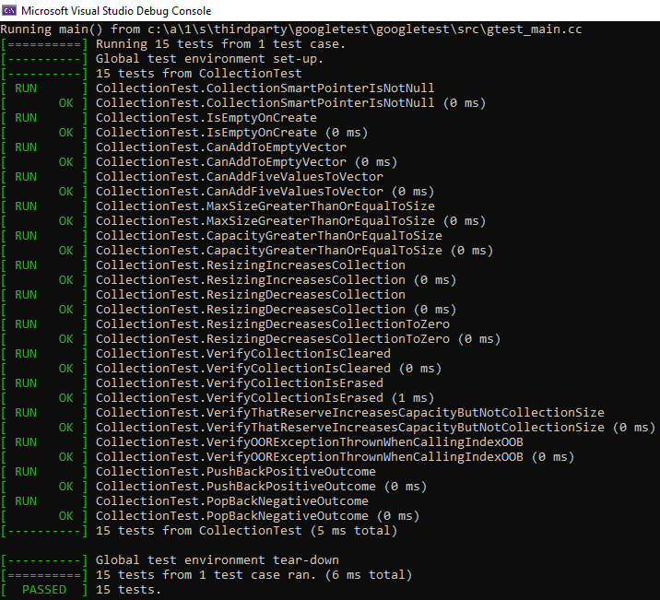
Unit Testing

Slide 13

AUTOMATION SUMMARY

Slide 14
TOOLS
The DevSecOps pipeline represents a set of processes and tools. It allows developers to cohesively work together to be able to create code productively. It has different steps in the pipeline that help developers to reach the end goal. It is also continuous – which is a key characteristic.
Design phase: static analysis tools as well as built-in IDE tools are used in this phase to help detect errors and potential problems.
Build phase: static analysis tools are used here, and they will give warnings of non-severe issues. If there are severe issues, the code will not compile.
Verify and test: automated analysis tools and automated testing tools are used.
Some tools include: Cppchecker, Parasoft, Coverity

Slide 15
RISKS AND BENEFITS
Problems
Software vulnerabilities that leave sensitive information exposed
Unexpected behavior of code that results in vulnerabilities
Vulnerabilities that are exposed and leave the system unprotected
Solutions
Defensive coding
Think about security at every step of development
Address security concerns by priority
Use security policies and principles as well as coding standards to the fullest degree
Risks
Cost and time of having to fix the system if vulnerabilities are exploited
There is the potential of damage to reputation
Loss of trust due to exploitation of vulnerabilities
Benefits
Secure system or application
High quality system
Maintain user’s trust

Slide 16
RECOMMENDATIONS
As of now this security policy is up to date, and thoroughly addresses security concerns and policies that will help to keep this system as secure as possible
This security policy should be updated if new risks are found, or as new vulnerabilities come up. That was security is maintained to the highest degree possible, and vulnerabilities are kept to a minimum.
Always adapt policies to be used with different languages and platforms to ensure that security policies are followed
Keep re-evaluating every so often, so the policy stays as up to date as possible

Slide 17
CONCLUSIONS
Security standards and principles should be followed and implemented to the highest degree possible
Security policy and standards should always be updated to reflect updates and changes
Always consider motivations of hackers, and make sure to stay on top of current hacks going on
Security should be adopted at every step of development
Zero trust is a strategy that can be used along with Triple-A Framework to keep the system secure

Slide 18
REFERENCES
ARR02-C. Explicitly specify array bounds, even if implicitly defined by an initializer - SEI CERT C Coding Standard - Confluence. (n.d.). Wiki.sei.cmu.edu. Retrieved April 30, 2022, from https://wiki.sei.cmu.edu/confluence/display/c/ARR02-C.+Explicitly+specify+array+bounds%2C+even+if+implicitly+defined+by+an+initializer
DCL03-C. Use a static assertion to test the value of a constant expression - SEI CERT C Coding Standard - Confluence. (n.d.). Wiki.sei.cmu.edu. Retrieved April 30, 2022, from https://wiki.sei.cmu.edu/confluence/display/c/DCL03-C.+Use+a+static+assertion+to+test+the+value+of+a+constant+expression
DCL31-C. Declare identifiers before using them - SEI CERT C Coding Standard - Confluence. (n.d.). Wiki.sei.cmu.edu. Retrieved April 30, 2022, from https://wiki.sei.cmu.edu/confluence/display/c/DCL31-C.+Declare+identifiers+before+using+them
ERR51-CPP. Handle all exceptions - SEI CERT C++ Coding Standard - Confluence. (n.d.). Wiki.sei.cmu.edu. Retrieved April 30, 2022, from https://wiki.sei.cmu.edu/confluence/display/cplusplus/ERR51-CPP.+Handle+all+exceptions
EXP53-CPP. Do not read uninitialized memory - SEI CERT C++ Coding Standard - Confluence. (n.d.). Wiki.sei.cmu.edu. https://wiki.sei.cmu.edu/confluence/display/cplusplus/EXP53-CPP.+Do+not+read+uninitialized+memory

Slide 19
REFERENCES
FIO51-CPP. Close files when they are no longer needed - SEI CERT C++ Coding Standard - Confluence. (n.d.). Wiki.sei.cmu.edu. Retrieved April 30, 2022, from https://wiki.sei.cmu.edu/confluence/display/cplusplus/FIO51-CPP.+Close+files+when+they+are+no+longer+needed
IDS00-J. Prevent SQL injection - SEI CERT Oracle Coding Standard for Java - Confluence. (n.d.). Wiki.sei.cmu.edu. Retrieved April 30, 2022, from https://wiki.sei.cmu.edu/confluence/display/java/IDS00-J.+Prevent+SQL+injection
INT32-C. Ensure that operations on signed integers do not result in overflow - SEI CERT C Coding Standard - Confluence. (n.d.). Wiki.sei.cmu.edu. Retrieved April 30, 2022, from https://wiki.sei.cmu.edu/confluence/display/c/INT32-C.+Ensure+that+operations+on+signed+integers+do+not+result+in+overflow
MEM50-CPP. Do not access freed memory - SEI CERT C++ Coding Standard - Confluence. (n.d.). Wiki.sei.cmu.edu. Retrieved April 30, 2022, from https://wiki.sei.cmu.edu/confluence/display/cplusplus/MEM50-CPP.+Do+not+access+freed+memory
Mylonas, L. (2018, November 27). AAA Security: An Introduction to Authentication, Authorisation and Accounting. Codebots. https://codebots.com/application-security/aaa-security-an-introduction-to-authentication-authorisation-accounting
Ryan. (2019, June 18). Encryption in-transit and Encryption at-rest - Definitions and Best Practices. Ryadel. https://www.ryadel.com/en/data-encryption-in-transit-at-rest-definitions-best-practices-tutorial-guide/
STR50-CPP. Guarantee that storage for strings has sufficient space for character data and the null terminator - SEI CERT C++ Coding Standard - Confluence. (n.d.). Wiki.sei.cmu.edu. Retrieved April 30, 2022, from https://wiki.sei.cmu.edu/confluence/display/cplusplus/STR50-CPP.+Guarantee+that+storage+for+strings+has+sufficient+space+for+character+data+and+the+null+terminator

